Slide 1
Decision Tree Model

Slide 2
Decision Tree
In principle, there are exponentially many decision trees that can be constructed from a given set of attributes.
Finding the optimal tree (in terms of performance) is computationally infeasible because of the exponential size of the search space.
Efficient algorithms have been developed to induce a reasonably accurate although suboptimal decision tree in a reasonable amount of time.
These algorithms usually employ a greedy strategy that grows a decision tree by making a series of locally optimum decision about which attribute to use for partitioning the data.
One such algorithm is Hunt’s algorithm, which is the basis of many decision tree induction algorithms, including ID3, C4.5, and CART.

Slide 3
Hunt’s Algorithm
In this algorithm, a decision tree is grown in a recursive fashion by partitioning the training records into successively purer subsets.
Let D_{t} be the set of training records that are associated with node t and y={y₁, y₂, …, y_{c}} be the class labels. The following is a recursive definition of Hunt’s algorithm:
Step 1: If all the records in D_{t} belong to the same class y_{t}, then t is a leaf node labelled as y_{t}.
Step 2: If D_{t} contains records that belong to more than one class, an attribute test condition is selected to partition the records into smaller subsets. A child node is created for each outcome of the test condition and the records in D_{t} are distributed to the children based on the outcomes.
The algorithm is then recursively applied to each child node.

Slide 4
Decision Tree Induction: ID3
Training data set: Buys_computer
Decision tree model is constructed using the Quinlan ID3 algorithm.
ID3 refers to Iterative Dichotomizer 3, and is developed by Ross Quinlan
It iteratively dichotomizes (divides) the data using a top down greedy approach.
The algorithm optimizes locally at each iteration.

Slide 5
Decision Tree Induction: ID3
Root is identified first, then the parents of next label, and so on of the decision tree are identified using entropy theory based optimization function
Resulting tree:
age?
<=30
31..40
>40
student?
yes
credit rating?
no
yes
excellent
fair
no
yes
no
yes

Slide 6
Algorithm of ID3
Basic algorithm (a greedy algorithm)
Tree is constructed in a top-down recursive divide-and-conquer manner
At start, all the training examples are at the root
Attributes are categorical (if continuous-valued, they are discretized in advance)
Examples are partitioned recursively based on selected attributes
Test attributes are selected on the basis of a heuristic or statistical measure (e.g., information gain)
Conditions for stopping partitioning
All samples for a given node belong to the same class
There are no remaining attributes for further partitioning – majority voting is employed for classifying the leaf
There are no samples left

Slide 7
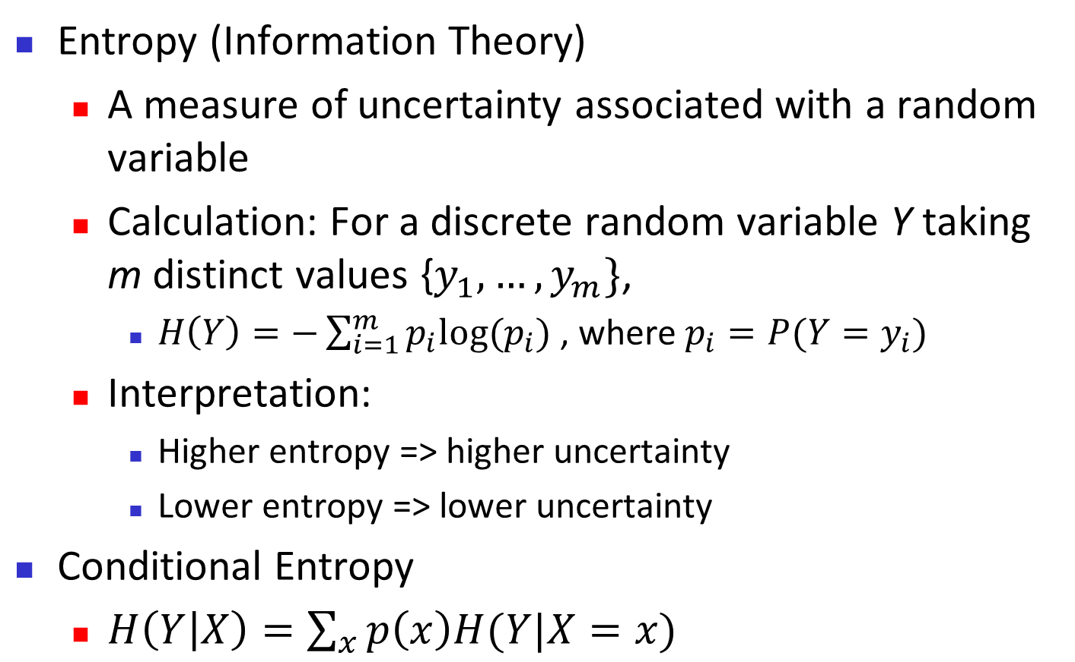
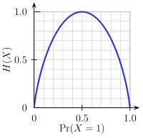
Brief Review of Entropy
Y/(X=x1) Y/(X=x2) ………. Y/(X=x) Y/( X=x_{n})
m = 2

Slide 8
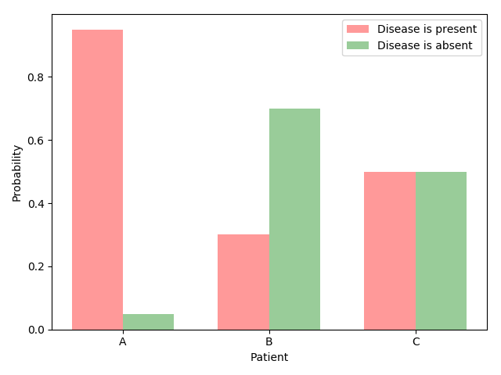
Entropy and uncertainty
Suppose three patients have completed a medical test which, yields one of two possible results: the disease is either present or absent.
Let Patient A has 95% chance that he has the disease. For Patient B and C it is 30% and 50%, respectively.
So, if A, B, and C are in waiting room of a doctor’s office, then the uncertainty of the waiting room is:

Slide 9
Entropy and uncertainty
All other things being equal, which of the three patients is confronted with the greatest degree of uncertainty?
I think the answer is clear: patient C.
Compare this with patient A. Patient A is experiencing little uncertainty with regard to his medical prospects.
Intuitively speaking, uncertainty of patient B falls in between that of A and C.
Measuring uncertainty: Entropy is a measure of uncertainty.
Entropy allows us to make precise statements and perform computations with regard to one of life’s most pressing issues: not knowing how things will turn out.
By the term entropy, I will refer to Shannon entropy, which is used most frequently in natural language processing and machine learning.

Slide 10
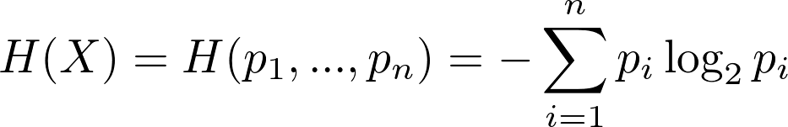
Entropy and uncertainty
The Shannon entropy formula for an event X with n possible outcomes and probabilities p₁, …, p_{n}:
For previous patients example,
H(A)=-0.95log(0.95)-0.05log(0.05)=0.08
H(B)= -0.7log(0.7)-0.3log(0.3)=0.27
H(C)= -0.5log(0.5)-0.5log(0.5)=0.3 (maximum)

Slide 11
Entropy and uncertainty
The Shannon entropy formula for an event X with n possible outcomes and probabilities p₁, …, p_{n}:
Basic properties of uncertainty:
Prop. 1: Uniform distributions have maximum uncertainty
If your goal is to minimize uncertainty, stay away from uniform probability distributions.

Slide 12
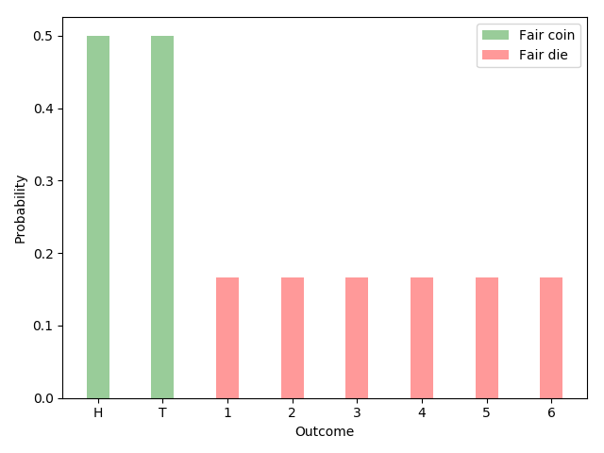
Prop -1 of uncertainty
A probability distribution is a function that assigns a probability to every possible outcome such that the probabilities add up to 1.
A distribution is uniform when all of the outcomes have the same probability.
For example, fair coins (50% heads, 50% tails) and fair dice (1/6 probability for each of the six faces) follow uniform distributions.

Slide 13
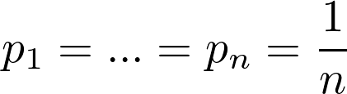
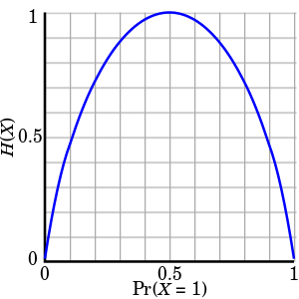
Prop -1 of uncertainty
A good measure of uncertainty achieves its highest values for uniform distributions.
Entropy satisfies the criterion. Given n possible outcomes, maximum entropy is maximized by equiprobable outcomes:
Here is the plot of the Entropy function as applied to Bernoulli trials (events with two possible outcomes and probabilities p and 1-p):
In the case of Bernoulli trials,
entropy reaches its
maximum value for p=0.5

Slide 14
Prop -2 of uncertainty
Prop-2: Uncertainty is additive for independent events
Let A and B be independent events. In other words, knowing the outcome of event A does not tell us anything about the outcome of event B.
The uncertainty associated with both events should be the sum of the individual uncertainties:
Let’s use the example of flipping two coins to make this more concrete. We can either flip both coins simultaneously or first flip one coin and then flip the other one.
In other words, we can either report the outcome of the two coin flips at once or separately. The uncertainty is the same in either case.

Slide 15
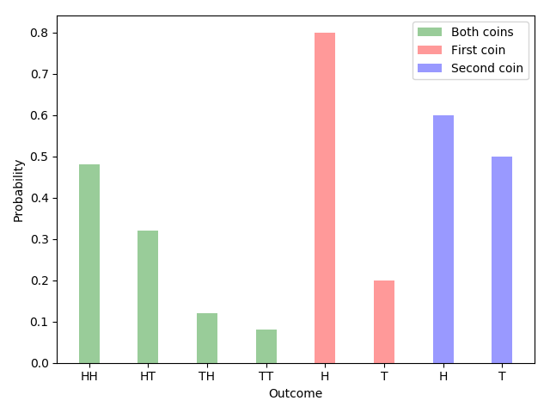
Prop -2 of uncertainty
Ex: Let the first coin lands heads (H) up with an 80% probability and tails (T) up with a probability of 20%.
The probabilities for the other coin are 60% and 40%.
If we flip both coins simultaneously, there are four possible outcomes: HH, HT, TH and TT. The corresponding probabilities are given by [ 0.48, 0.32, 0.12, 0.08 ].
The joint entropy (green) for the two independent events is equal to the sum of the individual events (red and blue).

Slide 16
Prop -2 of uncertainty
Plugging the numbers into the entropy formula, we see that: Just as promised,

Slide 17
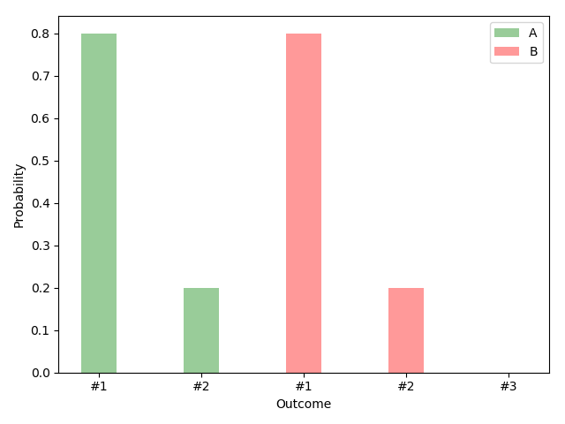
Prop -3 of uncertainty
Prop-3: Adding an outcome with zero probability has no effect
Suppose (a) you win whenever outcome #1 occurs and (b) you can choose between two probability distributions, A and B.
Distribution A has two outcomes: say, 80% and 20%. Distribution B has three outcomes with probabilities 80%, 20% and 0%.

Slide 18
Prop -3 of uncertainty
Given the options A and B, which one would you choose?
Ans: The inclusion of the third outcome neither increases nor decreases the uncertainty associated with the game. A or B, who cares. It doesn’t matter.
The entropy formula agrees with this assessment:
In words, adding an outcome with zero probability has no effect on the measurement of uncertainty.

Slide 19
Prop -4 of uncertainty
Prop-4: The measure of uncertainty is continuous in all its arguments
The last of the basic properties is continuity.
Famously, the intuitive explanation of a continuous function is that arbitrarily small changes in the output (uncertainty, in our case) should be achievable through sufficiently small changes in the input (probabilities).
Logarithm functions are continuous at every point for which they are defined. So are sums and products of a finite number of functions that are continuous on a subset.
It follows that the entropy function is continuous in its probability arguments.

Slide 20
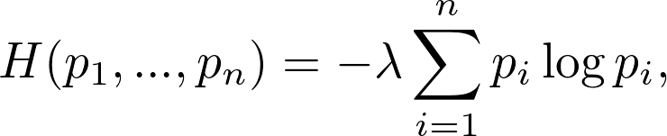
Entropy
The Uniqueness Theorem: Khinchin (1957) showed that the only family of functions satisfying the four basic properties described above is of the following form:
where λ is a positive constant. Khinchin referred to this as the Uniqueness Theorem.
Setting λ = 1 and using the binary logarithm gives us the Shannon entropy.
To reiterate, entropy is used because it has desirable properties and is the natural choice among the family functions that satisfy all items on the basic properties.

Slide 21
Entropy
Other properties of Entropy:
Entropy has many other properties used in Khinchin’s Uniqueness Theorem. Some of them:
Prop-5: Uniform distributions with more outcomes have more uncertainty
Suppose you have the choice between a fair coin and a fair die:
Fair coin or fair die ?
Let, A for coin and B for die.
H(A)=- 0.5ln(0.5) - 0.5ln(0.5) = 0.69
H(B)=[-(1/6)ln(1/6)] x 6=1.8

Slide 22

Entropy
And let’s say you win if the coin lands heads up or the die lands on face 1.
Which of the two options would you choose?
(i) if you are a profit maximizer and
(ii) if you prefer with more variety and uncertainty.
As the number of equiprobable outcomes increases, so should our measure of uncertainty.
And this is exactly what Entropy does: H(1/6, 1/6, 1/6, 1/6, 1/6, 1/6) > H(0.5, 0.5).
And, in general, if we let L(k) be the entropy of a uniform distribution with k possible outcomes,
for m> n

Slide 23
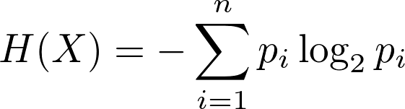
Entropy
Prop-6: Events have non-negative uncertainty
Do you know what negative uncertainty is? Neither do I.
A user-friendly measure of uncertainty should always return a non-negative quantity, no matter what the input is.
This is yet another criterion that is satisfied by entropy. Let’s take another look at the formula:
Probabilities are, by definition,
in the range between 0 and 1 and, therefore, non-negative.
The logarithm of a probability is non-positive. Multiplying the logarithm of a probability with a probability doesn’t change the sign. The sum of non-positive products is non-positive. And finally, the negative of a non-positive value is non-negative.
Entropy is, thus, non-negative for every possible input.

Slide 24
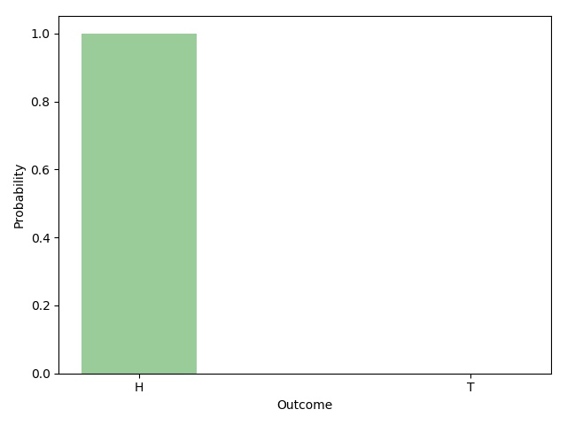
Entropy
Prop-7: Events with a certain outcome have zero uncertainty
Suppose you are in possession of a magical coin. No matter how you flip the coin, it always lands head up.
Suppose that outcome i certain to occur. It follows that pi, the probability of outcome i, is equal to 1. H(X), thus, simplifies to:

Slide 25
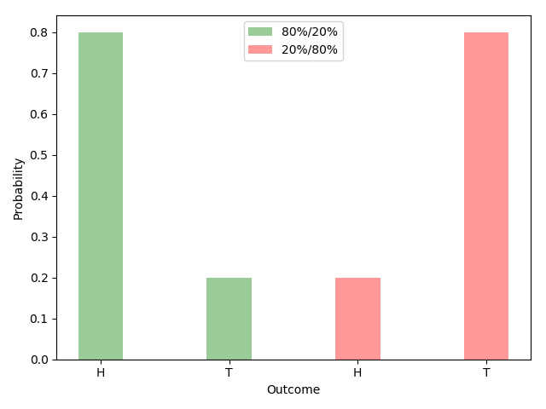
Entropy
Prop-8: Flipping the arguments has no effect
This is another obviously desirable property. Consider two cases. In the first case, the probability of heads and tails are 80% and 20%. In the second case, the probabilities are reversed: heads 20%, tails 80%.

Slide 26

Entropy
Both coin flips are equally uncertain and have the same entropy: H(0.8, 0.2) = H(0.2, 0.8).
In more general terms, for the case of two outcomes, we have:
This fact applies to any number of outcomes. We can position the arguments (i.e., the probabilities of a distribution) in any order we like. The result of the entropy function is always the same.

Slide 27
Attribute Selection Measure: Information Gain (ID3/C4.5)
Select the attribute with the highest information gain
Let p_{i} be the probability that an arbitrary tuple in D belongs to class C_{i} , estimated by |C_{i, D}|/|D|
Entropy (a measure of unpredictability or impurity) of the class or target variable in the dataset = Expected information needed to classify a tuple in D:
Entropy of the target variable after split the dataset D based on a feature A = Weighted average of the entropies of the subsets formed by the split of D using A = Information needed (after using A to split D into v partitions) to classify a tuple in D:
Notes:
I : the expected information needed to classify a given sample
E (entropy) : expected information based on the partitioning into subsets by A

Slide 28
Attribute Selection Measure: Information Gain (ID3/C4.5)
The information gain is the difference between the entropy before the split and the entropy after the split.
Information gain is the reduction in entropy after a dataset is split on a feature.
A higher information gain indicates that the feature provides a better separation of the target variable, making it a preferred choice for splitting the dataset in decision tree algorithms.
Notes:
I : the expected information needed to classify a given sample
E (entropy) : expected information based on the partitioning into subsets by A

Slide 29
Attribute Selection: Information Gain
Class P: buys_computer = “yes”
Class N: buys_computer = “no”
means “age <=30” has 5 out of 14 samples, with 2 yes’es and 3 no’s. Hence
Similarly,

Slide 30
Computing Information-Gain for Continuous-Valued Attributes
Let attribute A be a continuous-valued attribute
Must determine the best split point for A
Sort the value A in increasing order
Typically, the midpoint between each pair of adjacent values is considered as a possible split point
(a_{i}+a_{i+1})/2 is the midpoint between the values of a_{i} and a_{i+1}
The point with the minimum expected information requirement for A is selected as the split-point for A
Split:
D1 is the set of tuples in D satisfying A ≤ split-point, and D2 is the set of tuples in D satisfying A > split-point

Slide 31
Gain Ratio for Attribute Selection (C4.5)
Information gain measure is biased towards attributes with a large number of values
C4.5 (a successor of ID3) uses gain ratio to overcome the problem (normalization to information gain)
GainRatio(A) = Gain(A)/SplitInfo(A)
Ex.
gain_ratio(income) = 0.029/1.557 = 0.019
Similarly, Gain_ratio(student) = 0.151/0.69=0.22
The attribute with the maximum gain ratio is selected as the splitting attribute

Slide 32
Gini Index
The Gini coefficient measures the inequality among the values of a frequency distribution, such as levels of income. In machine learning, it is utilized as an impurity measure in decision tree algorithms for classification tasks.
The Gini index is the most commonly used measure of inequality. It was developed by Italian statistician Corrado Gini and is named after him.
A Gini coefficient of 0 reflects perfect equality, where all income or wealth values are the same, while a Gini coefficient of 1 (or 100%) reflects maximal inequality among values, a situation where a single individual has all the income while all others have none.

Slide 33
Gini Index (CART, IBM IntelligentMiner)
If a data set D contains examples from n classes, gini index, gini(D) is defined as
where p_{j} is the relative frequency of class j in D
If a data set D is split on A into two subsets D₁ and D₂, the gini index gini(D) is defined as
Reduction in Impurity:
The attribute provides the largest reduction in impurity is chosen to split the node.

Slide 34
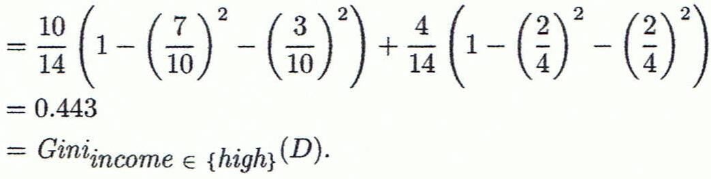
Computation of Gini Index
Ex. D has 9 tuples in buys_computer = “yes” and 5 in “no”
Suppose the attribute income partitions D into 10 in D₁: {low, medium} and 4 in D₂
Gini_{{low,high}} is 0.458; Gini_{{medium,high}} is 0.450. Thus, split on the {low,medium} (and {high}) since it has the lowest Gini index

Slide 35
Comparing Attribute Selection Measures
The three measures, in general, return good results but
Information gain:
biased towards multivalued attributes
Gain ratio:
tends to prefer unbalanced splits in which one partition is much smaller than the others
Gini index:
biased to multivalued attributes
has difficulty when # of classes is large

Slide 36
Other Attribute Selection Measures
CHAID: a popular decision tree algorithm, measure based on χ² test for independence
C-SEP: performs better than info. gain and gini index in certain cases
G-statistic: has a close approximation to χ² distribution
MDL (Minimal Description Length) principle (i.e., the simplest solution is preferred):
The best tree as the one that requires the fewest # of bits to both (1) encode the tree, and (2) encode the exceptions to the tree
Multivariate splits (partition based on multiple variable combinations)
CART: finds multivariate splits based on a linear comb. of attrs.
Which attribute selection measure is the best?
Most give good results, none is significantly superior than others

Slide 37
Overfitting and Tree Pruning
Overfitting: An induced tree may overfit the training data
Too many branches, some may reflect anomalies due to noise or outliers
Poor accuracy for unseen samples
Two approaches to avoid overfitting
Prepruning: Halt tree construction early ̵ do not split a node if this would result in the goodness measure falling below a threshold
Difficult to choose an appropriate threshold
Postpruning: Remove branches from a “fully grown” tree—get a sequence of progressively pruned trees
Use a set of data different from the training data to decide which is the “best pruned tree”

